Slide 1
FIN 654: FINANCIAL Analytics
SUPPLEMENT Week 5
Note: Code contained here is from a mix of sources as listed in References Slide(s)

Slide 2
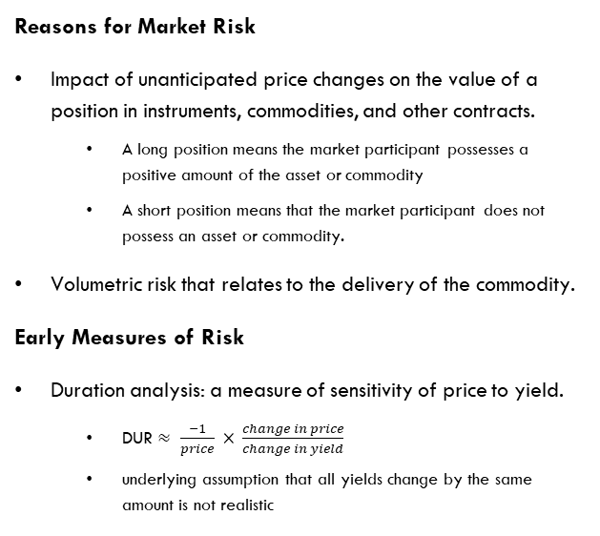
Risk Management
Financials & financial innovations are always risky
Market risk is the risk due to changes in prices.
Credit risk is the danger that a counterparty does not meet contractual obligations. Example: not making monthly payments on a home loan.
Liquidity risk is the potential of incurring added cost of liquidating a position because buyers are difficult to locate.
Operational risk stems from omissions & errors, fraud, mismanagement, and similar problems.
Reasons for Market Risk
Impact of unanticipated price changes on the value of a position in instruments, commodities, and other contracts.
A long position means the market participant possesses a positive amount of the asset or commodity
A short position means that the market participant does not possess an asset or commodity.
Volumetric risk that relates to the delivery of the commodity.
Early Measures of Risk
Duration analysis: a measure of sensitivity of price to yield.
DUR $≈ \frac{−1}{price} × \frac{change in price}{change in yield}$
underlying assumption that all yields change by the same amount is not realistic

Slide 3
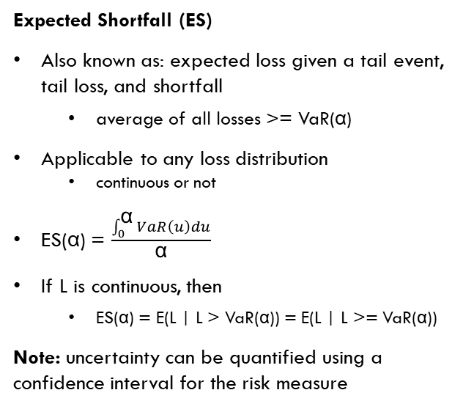
Common Risk Measures
Value-at-Risk (VaR)
Uses two parameters, the time horizon (T) and the tolerance level (α) OR confidence level (1-α)
Applicable to any loss distribution
continuous or not
If L is the loss over the holding period T, then VaR(α) is the α-th upper quantile of L
If R = L is the revenue, then VaR(α) is minus the α-th quantile of R
P(L > VaR(α)) = P(L >= VaR(α)) = α
Expected Shortfall (ES)
Also known as: expected loss given a tail event, tail loss, and shortfall
average of all losses >= VaR(α)
Applicable to any loss distribution
continuous or not
ES(α) = $\frac{\int_{0}^{\text{α}}{VaR\left(u\right)du}}{\text{α}}$
If L is continuous, then
ES(α) = E(L | L > VaR(α)) = E(L | L >= VaR(α))
Note: uncertainty can be quantified using a confidence interval for the risk measure

Slide 4
Risk Measures – Techniques
Non-parametric techniques
# Simple Value at Risk
alpha.tolerance <- 0.99
(VaR.hist <- quantile(loss.rf,
probs = alpha.tolerance, names = FALSE))
# Just as simple Expected shortfall
(ES.hist <- mean(loss.rf[loss.rf > VaR.hist]))
Note:
Value at Risk (VaR) is the negative of the predicted distribution quantile at the selected probability level.
Expected Shortfall (ES) is the negative of the expected value of the tail beyond the VaR
Parametric techniques
Set weights (specify positions)
Estimate the mean vector and the variance-covariance matrix
Set the level of risk tolerance
Gaussian: rnorm()
Student’s t thresholds: rt() = ratio of a Gaussian random variate to the square root of a chi-squared random variate
Chi-square: “half-way” between the above two

Slide 5

Extreme Tail Distributions
Generalized Pareto Distribution
Behavior in excess of the threshold
Mean excess over the threshold is linear in the threshold
A random variable with heavy tails has the following property: The sum of random variables is completely determined by the value of a single outlier.
The tails are modelled semi-parametrically
Note: Distributions whose tails decrease exponentially, such as the normal, correspond to a zero shape parameter. Distributions with finite tails, such as the beta, correspond to a negative shape parameter.
fit.GPD() in library QRM
For shape parameters ξ >= 0, distribution is:
For shape parameters ξ = 0, distribution is:
If u is an upper (very high) threshold, then the excess of threshold function for the GPD is:
Note: Plot should look roughly uniform since the GPD excess loss function is a linear function of thresholds u.

Slide 6
Reference books
Bennet and Hugen. 2016. Financial Analytics with R: Cambridge Univ Press.
Paul Teetor. 2011. R Cookbook. O’Reilly: Sebastopol, CA.
Phil Spector. Data Manipulation with R.
Norman Matloff. The Art of R Programming: A Tour of Statistical Software Design.
John Taveras. R for Excel Users at https://www.rforexcelusers.com/book/.
Winston Chang. 2014. R Graphics Cookbook. O’Reilly: Sebastopol, CA.

Slide 7
Reference links
http://www.cookbook-r.com/
https://books.google.com/books?id=fxL4tu5bzAAC&printsec=frontcover
https://www.datacamp.com/courses/free-introduction-to-r
http://www.r-tutor.com/r-introduction/
https://www.statmethods.net/
https://livebook.manning.com/#!/book/r-in-action-second-edition/
https://blog.rstudio.com/2015/06/24/leaflet-interactive-web-maps-with-r/
https://www.analyticsvidhya.com/blog/2015/07/guide-data-visualization-r/
https://jabranham.com/blog/2015/09/rmarkdown-vs-latex/
https://www.revolvy.com/main/index.php?s=YAML

Slide 8
Data Sources
https://finance.google.com/finance
https://finance.yahoo.com/quote/<sym>/history?ltr=1 ## <sym> is ticker symbol
https://fred.stlouisfed.org/categories
https://www.eia.gov/<energy>/data.php ## <energy> is petroleum, naturalgas, electricity, etc.
https://www.indexmundi.com/commodities/
https://www.lme.com/en-GB/Market-Data
https://www.oanda.com/forex-trading/analysis/economic-indicators/united-states
https://www.quandl.com/search?query=
https://www.treasurydirect.gov/govt/reports/pd/mspd/mspd.htm
http://www.wsj.com/mdc/public/page/2_3020-tstrips.html

